Slide 1
De-hazing De-smoking algorithm
Title :
AI-ML based intelligent de-smoking/de-hazing algorithm
Domain:
Disaster Management

Slide 2
Problem Statement:
Design and Development of AI-ML based intelligent de- smoking/de-hazing algorithm for reproducing images of the area under fire specifically for indoor fire hazards to aid the rescue operation.

Slide 3
Motivation:
The motivation behind the project is to address the challenges faced by the fire department during critical rescue scenarios. Indoor fire accidents, wildfires, or any other fire calamities result in thick smoke or haze, creating difficulties in vision. By clearing the vision, we can identify the victims of the calamity. The project aims to create an intelligent algorithm that effectively mitigates smoke and haze in real-time images feeds, empowering rescue teams with enhanced visibility. This improvement can facilitate efficient navigation, accelerate victim location, optimize resource allocation, and foster better communication among team members.

Slide 4
Abstract:
The project aims to develop an intelligent de-smoking/de-hazing algorithm using AI and ML technologies to address challenges encountered during critical rescue scenarios, specifically in indoor fire accidents, wildfires, or other fire calamities. Thick smoke or haze generated in such situations improves visibility, hindering effective rescue operations. The proposed algorithm seeks to clear vision in real-time video feeds, empowering rescue teams with enhanced visibility. This enhancement is expected to facilitate efficient navigation, expedite victim location, optimize resource allocation, and improve communication among team members.

Slide 5
Features:
Vision enhancement.
Contrast Enhancement
Color Restoration
Edge Detection
Adaptive Parameter Adjustment
High-Resolution Support
User-Friendly Interface
Cross-Platform Accessibility

Slide 6
Uses:
Surveillance
Military and Defense
Implementation platforms
CCTV’s
Underwater Imaging
Fire Department
Aiding Autonomous Vehicles
Environmental Monitoring
Medical Imaging
Archaeology
Content Creation and Enhancement

Slide 7
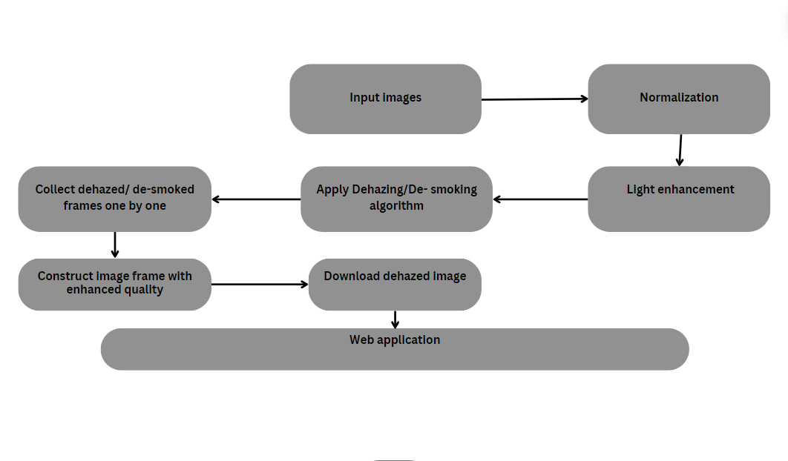
System Architecture​

Slide 8
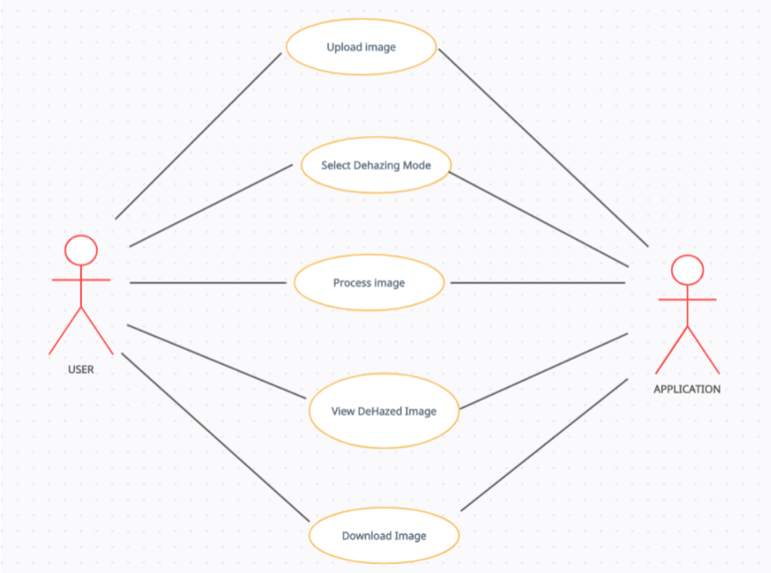
Use case Diagram

Slide 9
Use Case Description:
1. Upload Image
Actor: User
Description: The user initiates the dehazing process by uploading an image to the system. This image may be sourced from the user's device or an integrated cloud storage service. Upon upload, the image is made available for processing by the system.
2. Select Dehazing Mode
Actor: User
Description: After uploading the image, the user selects the dehazing mode, choosing between automatic or manual settings adjustment. In automatic mode, the system applies pre-defined parameters for dehazing. In manual mode, the user has the option to adjust specific parameters like airlight estimation, boundary constraint, and regularization to customize the dehazing process according to their preferences.

Slide 10
3. Process Image
Actor: User
Description: Once the dehazing mode is selected, the system processes the uploaded image using the chosen settings. In automatic mode, the system applies built-in algorithms to remove haze from the image. In manual mode, the system adjusts the dehazing parameters based on the user's input and processes the image accordingly.
4. View Dehazed Image
Actor: User
Description: After processing, the system presents the dehazed image to the user for review. The user can examine the result and assess whether the dehazing process has achieved the desired outcome in improving image clarity and removing haze artifacts.
5. Download Dehazed Image
Actor: User
Description: If satisfied with the dehazed image, the user can proceed to download the final result. The system provides an option for the user to save the dehazed image to their device or preferred storage location for further use or sharing purposes.

Slide 11
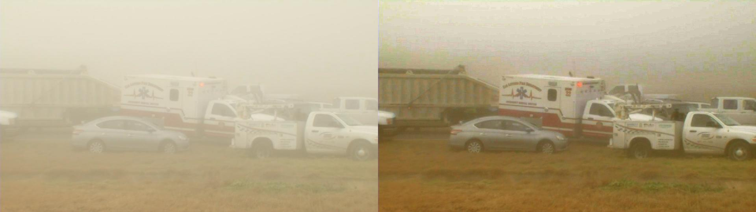
Input:
Expected Output:

Slide 12




Technology stack:
OpenCV
Machine learning
Python
PyTorch

Slide 13
Team Members:
P.Bhargav 1602-21-737-013
P.Sai charan 1602-21-737-045
D.Jayanth 1602-21-737-022

